Slide 1
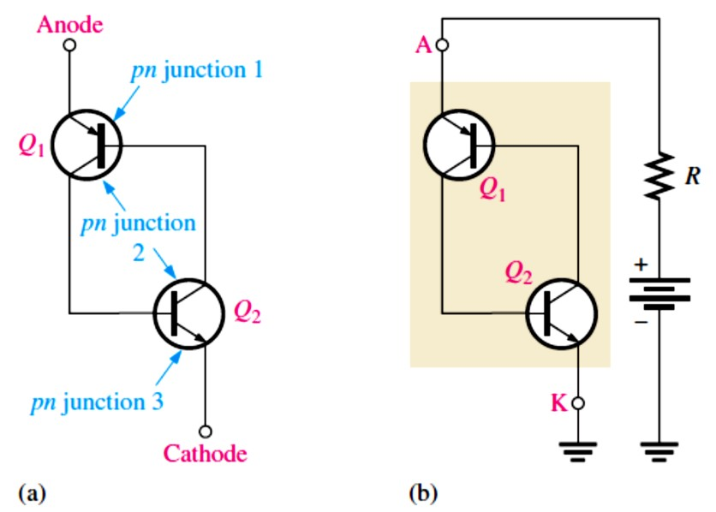
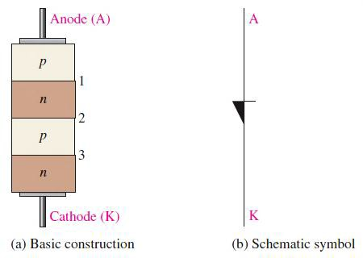
Lecture 11: Thyristors
In this Lecture, several types of semiconductor devices are introduced.
A family of devices known as thyristors are constructed of four semiconductor layers (pnpn).
Thyristors include the 4-layer diode, the silicon-controlled rectifier (SCR), the diac, the triac, the silicon-controlled switch (SCS), the unijunction transistor (UJT), and the programmable unijunction transistor (PUT).
Thyristors can be used to control the amount of ac power to a load and are used in lamp dimmers, motor speed controls, ignition systems, and charging circuits, to name a few.
11.1 The Four-Layer Diode
The basic thyristor is a 4-layer device with two terminals, the anode and the cathode. It is constructed with four semiconductor layers (pnpn).
The 4-layer diode is a thyristor that conducts when the voltage across its terminals exceeds the breakover potential.
The device acts as a switch and remains off until the forward voltage reaches a certain value; then it turns on and conducts.
Conduction continues until the current is reduced below a specified value.
Shockley Diode: The 4-layer diode shown in Figure 11-1 (also known as Shockley diode and SUS) is a type of thyristor.
The pnpn structure can be represented by an equivalent circuit consisting of a pnp transistor
and an npn transistor, as shown in Figure 11-2.
➢
FIGURE 11-1: The 4-layer diode. FIGURE 11-2: A 4-layer diode equivalent circuit.
Forward-Breakover Voltage: The operation of the 4-layer diode may seem unusual because when it is forward-biased, it can act essentially as an open switch.

Slide 2
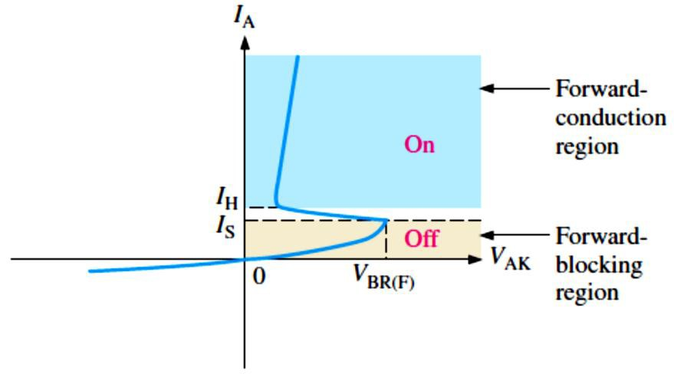
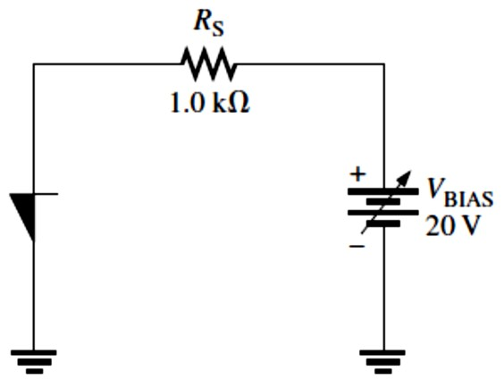
There is a region of forward bias, called the forward-blocking region, in which the device has a very high forward resistance (ideally an open) and is in the off state.
The forward-blocking region as shown in Figure 11-3 exists from �_{AK} = 0 V up to a value of �_{AK} called the forward-breakover voltage, 𝑽_{𝐁�(𝐅)}.
FIGURE 11-3: A 4-layer diode characteristic curve.
Holding Current (𝑰_{𝐇}): The value of the anode current below which a device switches from the forward-conduction region (on) to the forward-blocking region (off).
Switching Current (𝑰�): The value of the anode current at the point where the device switches from the forward-blocking region (off) to the forward-conduction region (on). The value of 𝑰�
is always less than 𝐼_{H}.
EXAMPLE 11-1: A certain 4-layer diode is biased in the forward-blocking region with an anode- to-cathode voltage of 20 V. Under this bias condition, the anode current is 1 μA. Determine the resistance of the diode in the forward-blocking region.
Solution The resistance is 𝑅_{AK} = �_{AK}⁄𝐼_{A} = 20 V⁄1 𝜇A = 20 MΩ
EXAMPLE 11-2: Determine the value of anode current in Figure 11-4 when the device is on.
�_{BR(F)} = 10 V. Assume the forward voltage drop is 0.9 V.
FIGURE 11-4
Solution The voltage at the anode, �_{A}, is 0.9. The voltage across 𝑅_{S} is
�_{𝑅S} = �_{BIAS} − �_{A} = 20 V − 0.9 V = 19.1 V
The anode current is
𝐼_{A} = �_{𝑅S} ⁄𝑅_{S} = 19.1 V⁄1.0 kΩ = 19.1 mA
An Application: The circuit in Figure 11-5(a) is a relaxation oscillator. The operation is as follows. When the switch is closed, the capacitor charges through R until its voltage reaches the forward-breakover voltage of the 4-layer diode. At this point the diode switches into conduction, and the capacitor rapidly discharges through the diode. Discharging continues

Slide 3
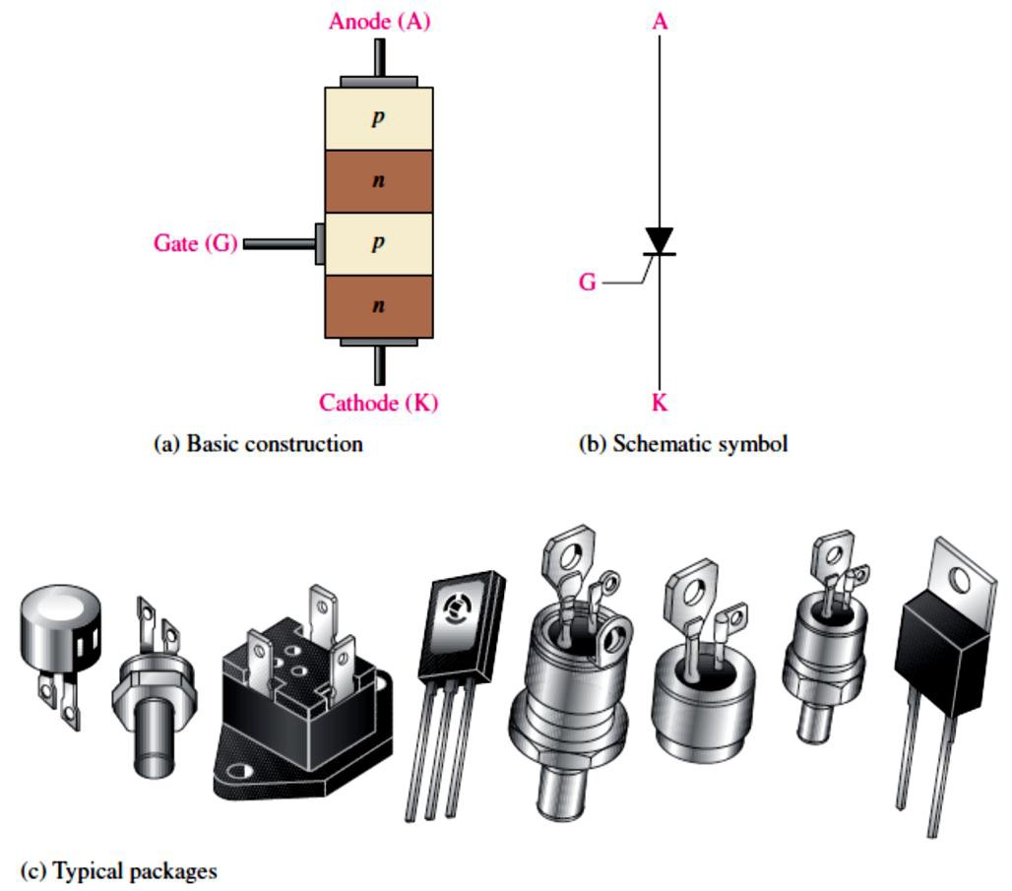
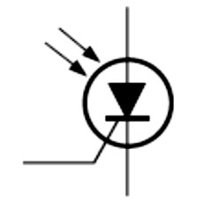
until the current through the diode falls below the holding value. At this point, the diode switches back to the off state, and the capacitor begins to charge again. The result of this action is a voltage waveform across 𝐶like that shown in Figure 11-5(b).
FIGURE 11-5: A 4-layer diode relaxation oscillator.
11.2 The Silicon-Controlled Rectifier (SCR)
The silicon-controlled rectifier (SCR) is shown in Figure 11-6 can be triggered on by a pulse at the gate and turned off by reducing the anode current below the specified holding value.
Light acts as the trigger source in light-activated SCRs (LASCRs) as shown in Figure 11-7.
FIGURE 11-6: The silicon-controlled rectifier (SCR).
FIGURE 11-7: LASCR symbol.

Slide 4
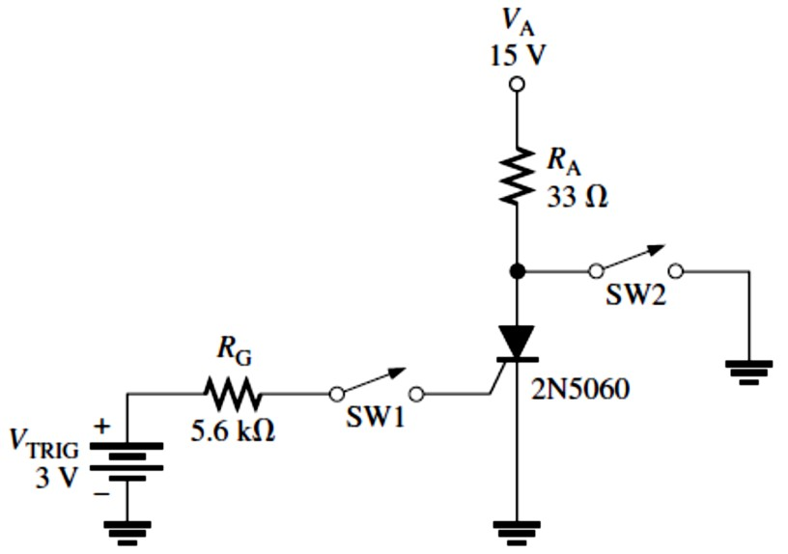
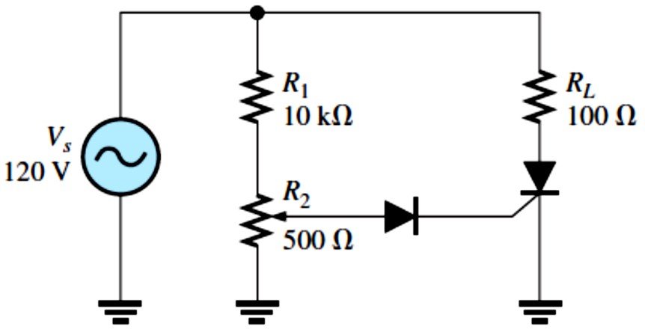
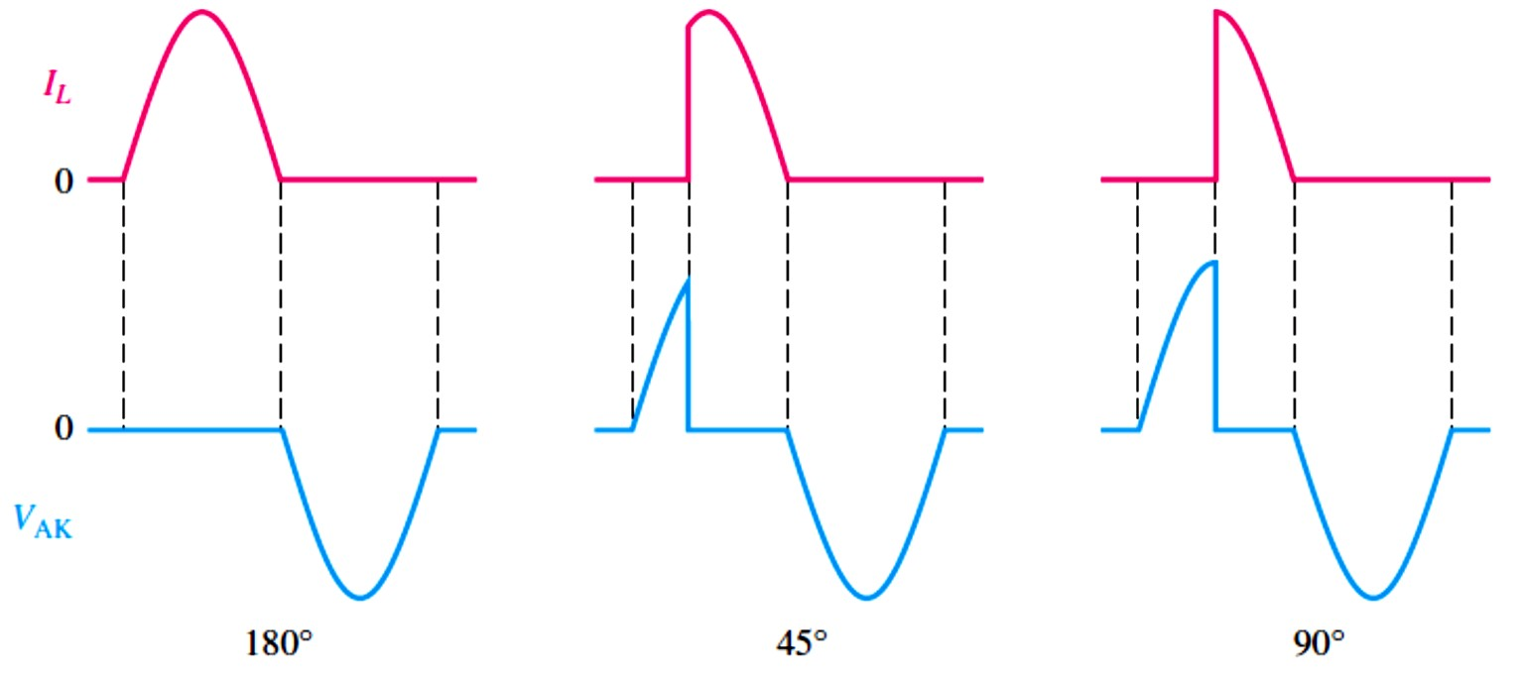
11.3 SCR Applications
The SCR is used in many applications, including motor controls, time-delay circuits, heater controls, phase controls, relay controls, and sawtooth generators.
EXAMPLE 11-3: Determine the gate trigger current and the anode current when the switch, SW1, is momentarily closed in Figure 11-8. Assume �_{AK} = 0.2 V, �_{GK} = 0.7 V, and 𝐼_{H} = 5 mA.
FIGURE 11-8
Solution
𝐼_{G} =
�TRIG ^{− �}GK
=
3 V − 0.7 V
= 410 𝜇A
𝑅
G
5.6 kΩ
𝐼_{A} =
�_{A} − �_{AK}
=
15 V − 0.2 V
= 448 mA
𝑅
A
33 Ω
EXAMPLE 11-4: Show the voltage waveform across the SCR in Figure 11-9 from anode to cathode (ground) in relation to the load current for 180°, 45°, and 90° conduction. Assume an ideal SCR.
FIGURE 11-9
Solution When there is load current, the SCR is conducting and the voltage across it is ideally zero. When there is no load current, the voltage across the
SCR is the same as the applied voltage. The waveforms are shown in Figure 11-10.
FIGURE 11-10

Slide 5
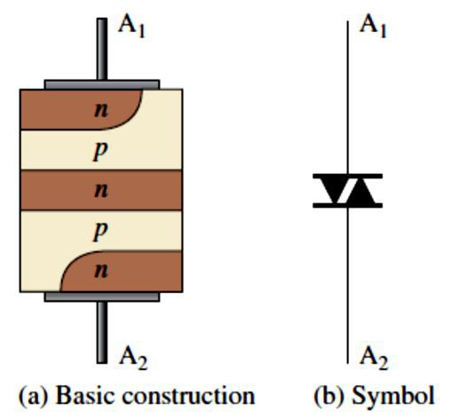
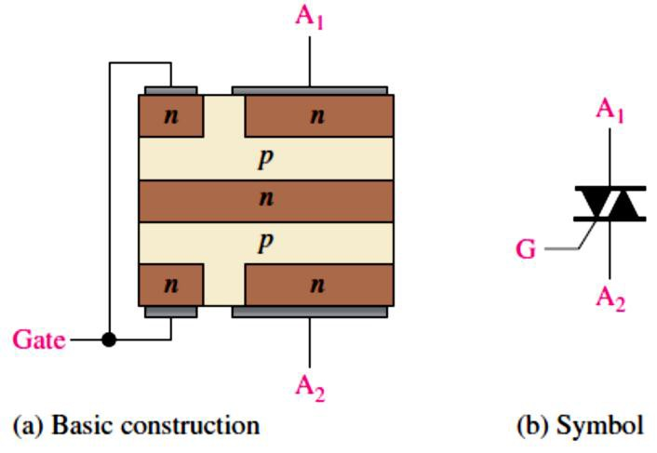
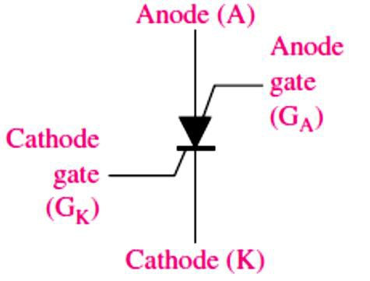
11.4 The Diac and Triac
The diac, as shown in Figure 11-11, can conduct current in either direction and is turned on when a breakover voltage is exceeded. It turns off when the current drops below the holding value.
The diac functions basically like two parallel 4-layer diodes turned in opposite directions.
The triac, as is shown in Figure 11-12, like the diac, is a bidirectional device. It can be turned on by a pulse at the gate and conducts in a direction depending on the voltage polarity across
the two anode terminals.
The triac functions basically like two parallel SCRs turned in opposite directions with a common gate terminal.
The difference between the two devices is that a diac has two terminals, while a triac has a third terminal, which is the gate for triggering.
Applications: Like the SCR, triacs are also used to control average power to a load by the method of phase control.
FIGURE 11-11: The diac.
11.5 The Silicon-Controlled Switch (SCS)
FIGURE 11-12: The triac.
The silicon-controlled switch (SCS) is similar in construction to the SCR.
The SCS, shown in Figure 11-13, has two gate terminals, the cathode gate and the anode gate, and can be turned on by a pulse at the cathode gate and turned off by a pulse at the anode gate.
Applications: The SCS and SCR are used in similar applications. The SCS has the advantage
of faster turn-off with pulses on either gate terminal; however, it is more limited in terms of maximum current and voltage ratings. Also, the SCS is sometimes used in digital applications such as counters, registers, and timing circuits.
FIGURE 11-13 The silicon-controlled switch (SCS).

Slide 6
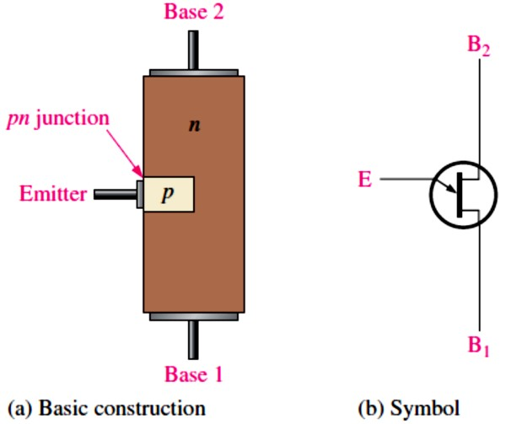
11.6 The Unijunction Transistor (UJT)
The unijunction transistor (UJT): as shown in Figure 11-14, is a three-terminal single pn
junction device that exhibits a negative resistance characteristic.
The UJT does not belong to the thyristor family because it does not have a four-layer type of construction.
The difference between UJT and a JFET symbol is that the arrow is at an angle for the UJT. The UJT has only one pn junction, and therefore, the characteristics of this device are different
from those of either the BJT or the FET.
The UJT is useful in certain oscillator applications and as a triggering device in thyristor circuits.
FIGURE 11-14: The unijunction transistor (UJT).
Standoff Ratio: The ratio 𝑟´_{B1}⁄𝑟´_{BB} is a UJT characteristic called the intrinsic standoff ratio
and is designated by 𝜂(Greek eta).
𝜼= 𝒓´_{𝐁�}⁄𝒓´_{𝐁�}
Equation 11– 1
where 𝑟´_{B1} is the internal dynamic resistance of the silicon bar between the emitter and base 1, and 𝑟´_{B2} is the dynamic resistance between the emitter and base 2. The total resistance between the base terminals is the sum of 𝑟´_{B1} and 𝑟´_{B2} and is called the interbase resistance,
𝑟´_{BB}. 𝑟´_{BB} = 𝑟´_{B1} + 𝑟´_{B2}
The intrinsic standoff ratio of a unijunction transistor (UJT) determines the voltage at which the device will trigger on.
The value of emitter voltage that causes the pn junction to become forward-biased is called �_{P} (peak-point voltage) and is expressed as
𝑽_{𝐏}= 𝜼𝑽_{𝐁�}+ 𝑽_{𝒑�}
where �_{𝑝�}is the barrier potential of the pn junction.
Equation 11– 2
EXAMPLE 11-5: The datasheet of a certain UJT gives 𝜂= 0.6. Determine the peak-point emitter voltage �_{P} if �_{BB} = 20 V.
Solution �_{P} = 𝜂�_{BB} + �_{𝑝�}= 0.6(20 V) + 0.7 V = 12.7 V

Slide 7
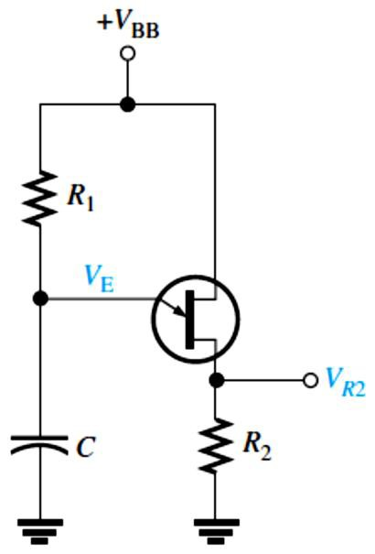
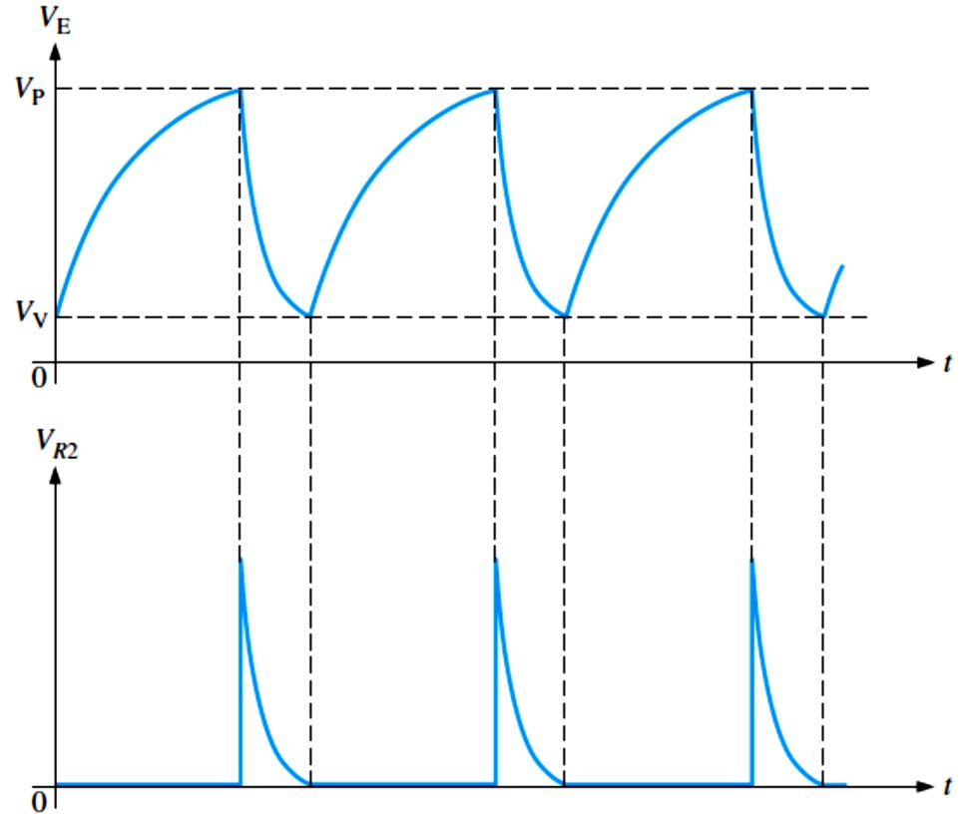
A UJT Application: The UJT can be used as a trigger device for SCRs and triacs. Other applications include nonsinusoidal oscillators, sawtooth generators, phase control, and timing circuits. Figure 11-15 shows a UJT relaxation oscillator as an example of one application.
FIGURE 11-15: Relaxation oscillator.
The operation is as follows. When dc power is applied, the capacitor 𝐶charges exponentially through 𝑅₁ until it reaches the peak-point voltage �_{P}. At this point, the pn junction becomes forward-biased, and the emitter characteristic goes into the negative resistance region (�_{E} decreases and 𝐼_{E} increases). The capacitor then quickly discharges through the forward-biased junction, 𝑟´_{B}, and 𝑅₂. When the capacitor voltage decreases to the valley-point voltage �_{V}, the UJT turns off, the capacitor begins to charge again, and the cycle is repeated, as shown in the emitter voltage waveform in Figure 11-16 (top). During the discharge time of the capacitor, the UJT is conducting. Therefore, a voltage is developed across 𝑅₂, as shown in the waveform diagram in Figure 11-16 (bottom).
FIGURE 11-16: Waveforms for UJT relaxation oscillator.

Slide 8
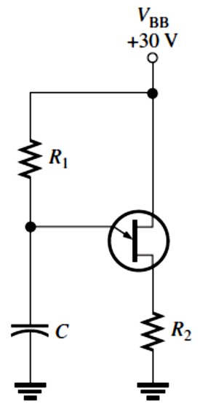
Conditions for Turn-On and Turn-Off: In the relaxation oscillator of Figure 11-15, certain conditions must be met for the UJT to reliably turn on and turn off. First, to ensure turn-on,
𝑅₁ must not limit 𝐼_{E} at the peak point to less than 𝐼_{P}. To ensure this, the voltage drop across
𝑅₁ at the peak point should be greater than 𝐼_{P}𝑅₁. Thus, the condition for turn-on is
�_{BB} − �_{P} > 𝐼_{P}𝑅₁
or
𝑅₁ < (�_{BB} − �_{P})⁄𝐼_{P}
To ensure turn-off of the UJT at the valley point, 𝑅₁ must be large enough that 𝐼_{E} (at the valley point) can decrease below the specified value of 𝐼_{V}. This means that the voltage across 𝑅₁ at the valley point must be less than 𝐼_{V}𝑅₁. Thus, the condition for turn-off is
�_{BB} − �_{V} < 𝐼_{V}𝑅₁
or
𝑅₁ > (�_{BB} − �_{V})⁄𝐼_{V}
Therefore, for a proper turn-on and turn-off, 𝑅₁ must be in the range
(�_{BB} − �_{P})⁄𝐼_{P} > 𝑅₁ > (�_{BB} − �_{V})⁄𝐼_{V}
EXAMPLE 11-6: Determine a value of 𝑅₁ in Figure 11-17 that will ensure proper turn-on and turn-off of the UJT. The characteristic of the UJT exhibits the following values: 𝜂= 0.5, �_{V} = 1 V, 𝐼_{V} = 10 mA, 𝐼_{P} = 20 𝜇A, and �_{P} = 14 V.
FIGURE 11-17
Solution
�_{BB} − �_{P > 𝑅>} �_{BB} − �_{V}
𝐼_{P}
30 V − 14 V
1
𝐼_{V}
30 V − 1 V
> 𝑅₁ >
20 𝜇A 10 mA
800 kΩ > 𝑅₁ > 2.9 kΩ
As we can see, 𝑅₁ has quite a wide range of possible values that will work.
11.7 The Programmable Unijunction Transistor (PUT)
The programmable unijunction transistor (PUT), as shown in Figure 11-18, is actually is a type of three-terminal thyristor that is triggered into conduction when the voltage at the anode exceeds the voltage at the gate and not like the UJT at all in terms of structure.
The only similarity to a UJT is that the PUT can be used in some oscillator applications to replace the UJT.

Slide 9
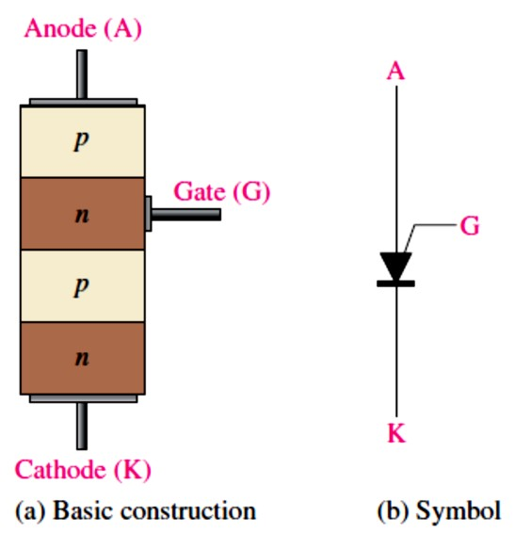
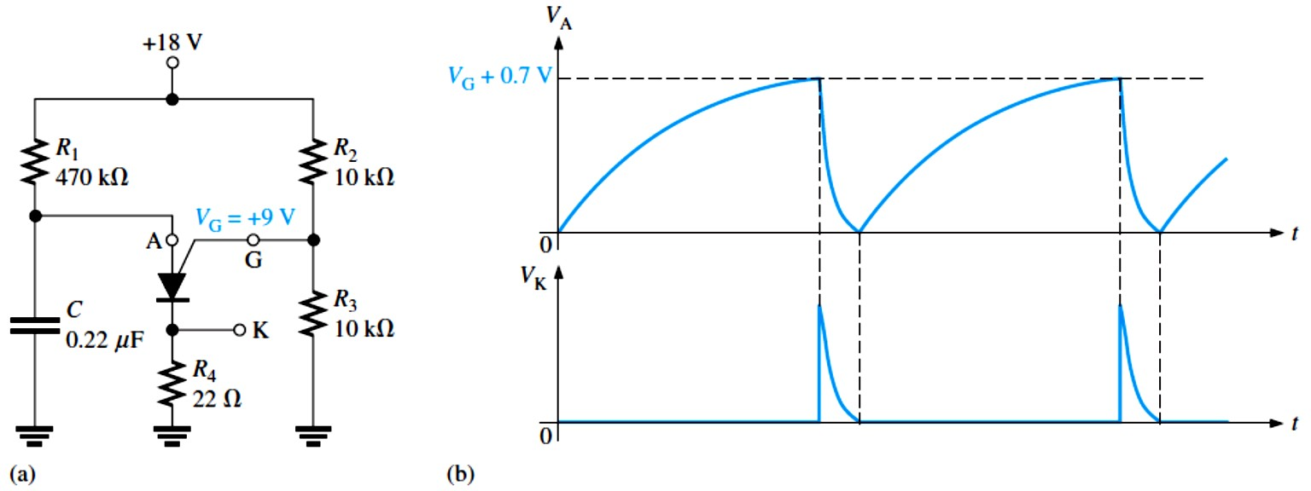
The PUT is similar to an SCR except that its anode-to-gate voltage can be used to both turn on and turn off the device.
FIGURE 11-18: The programmable unijunction transistor (PUT).
An Application: A plot of a characteristic curve similar to that of the UJT. Therefore, the PUT replaces the UJT in many applications. One such application is the relaxation oscillator in Figure 11-19 (a).
The basic operation of the PUT is as follows. The gate is biased at +9 V by the voltage divider consisting of resistors 𝑅₂ and 𝑅₃. When dc power is applied, the PUT is off and the
capacitor charges toward +18 V through 𝑅₁. When the capacitor reaches �_{G} + 0.7 V, the PUT turns on and the capacitor rapidly discharges through the low on resistance of the PUT
and 𝑅₄. A voltage spike is developed across 𝑅₄ during the discharge. As soon as the capacitor discharges, the PUT turns off and the charging cycle starts over, as shown by the
waveforms in Figure 11-19(b).
FIGURE 11-19: PUT relaxation oscillator.

